Slide 1


Data-Intensive Computing with MapReduce
Session 7: Clustering and Classification
Jimmy Lin
University of Maryland
Thursday, March 7, 2013
This work is licensed under a Creative Commons Attribution-Noncommercial-Share Alike 3.0 United States See http://creativecommons.org/licenses/by-nc-sa/3.0/us/ for details

Slide 2
Today’s Agenda
Personalized PageRank
Clustering
Classification

Slide 3
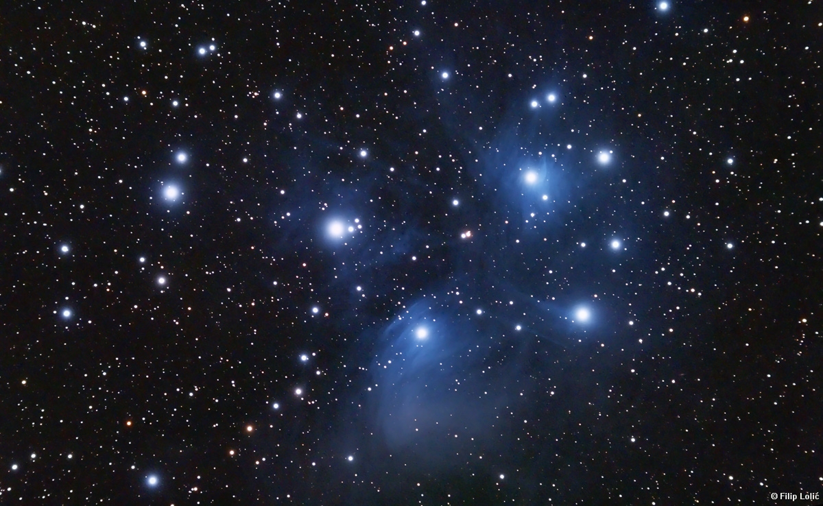
Clustering
Source: Wikipedia (Star cluster)

Slide 4
Problem Setup
Arrange items into clusters
High similarity between objects in the same cluster
Low similarity between objects in different clusters
Cluster labeling is a separate problem

Slide 5
Applications
Exploratory analysis of large collections of objects
Image segmentation
Recommender systems
Cluster hypothesis in information retrieval
Computational biology and bioinformatics
Pre-processing for many other algorithms

Slide 6
Three Approaches
Hierarchical
K-Means
Gaussian Mixture Models

Slide 7
Hierarchical Agglomerative Clustering
Start with each document in its own cluster
Until there is only one cluster:
Find the two clusters c_{i} and c_{j}, that are most similar
Replace c_{i} and c_{j} with a single cluster c_{i} ∪ c_{j}
The history of merges forms the hierarchy

Slide 8
HAC in Action
A B C D E F G H

Slide 9
Cluster Merging
Which two clusters do we merge?
What’s the similarity between two clusters?
Single Link: similarity of two most similar members
Complete Link: similarity of two least similar members
Group Average: average similarity between members

Slide 10
Link Functions
Single link:
Uses maximum similarity of pairs:
Can result in “straggly” (long and thin) clusters due to chaining effect
Complete link:
Use minimum similarity of pairs:
Makes more “tight” spherical clusters

Slide 11
MapReduce Implementation
What’s the inherent challenge?
One possible approach:
Iteratively use LSH to group together similar items
When dataset is small enough, run HAC in memory on a single machine
Observation: structure at the leaves is not very important

Slide 12
K-Means Algorithm
Let d be the distance between documents
Define the centroid of a cluster to be:
Select k random instances {s₁, s₂,… s_{k}} as seeds.
Until clusters converge:
Assign each instance x_{i} to the cluster c_{j} such that d(x_{i}, s_{j}) is minimal
Update the seeds to the centroid of each cluster
For each cluster c_{j}, s_{j} = μ(c_{j})

Slide 13
K-Means Clustering Example
Pick seeds
Reassign clusters
Compute centroids
Reassign clusters
◉
◉
Compute centroids
◉
◉
Reassign clusters
Converged!

Slide 14
Basic MapReduce Implementation
(Just a clever way to keep track of denominator)

Slide 15
MapReduce Implementation w/ IMC

Slide 16
Implementation Notes
Standard setup of iterative MapReduce algorithms
Driver program sets up MapReduce job
Waits for completion
Checks for convergence
Repeats if necessary
Must be able keep cluster centroids in memory
With large k, large feature spaces, potentially an issue
Memory requirements of centroids grow over time!
Variant: k-medoids

Slide 17
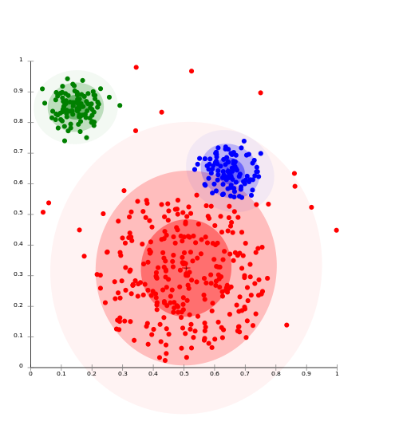
Clustering w/ Gaussian Mixture Models
Model data as a mixture of Gaussians
Given data, recover model parameters
Source: Wikipedia (Cluster analysis)

Slide 18
Gaussian Distributions
Univariate Gaussian (i.e., Normal):
A random variable with such a distribution we write as:
Multivariate Gaussian:
A vector-value random variable with such a distribution we write as:

Slide 19
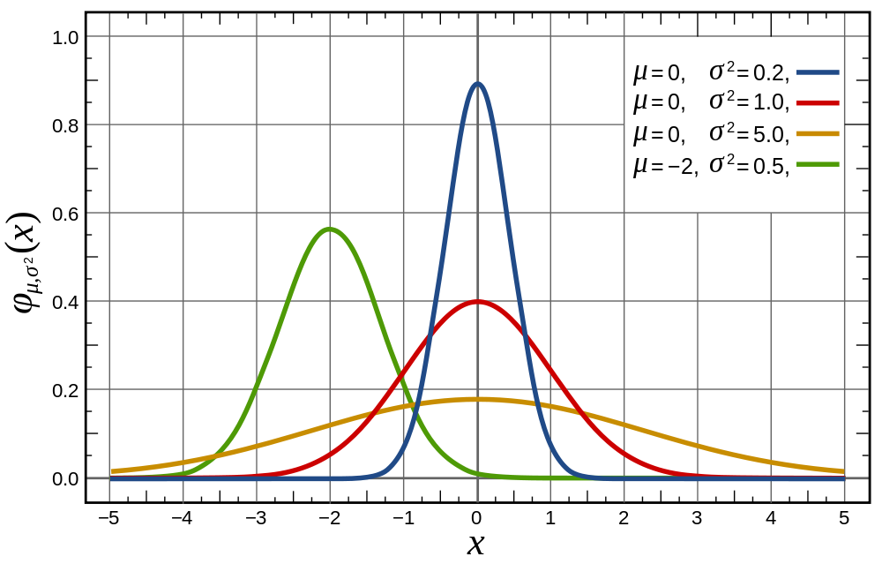
Univariate Gaussian
Source: Wikipedia (Normal Distribution)

Slide 20
Multivariate Gaussians
Source: Lecture notes by Chuong B. Do (IIT Delhi)

Slide 21
Gaussian Mixture Models
Model parameters
Number of components:
“Mixing” weight vector:
For each Gaussian, mean and covariance matrix:
Varying constraints on co-variance matrices
Spherical vs. diagonal vs. full
Tied vs. untied

Slide 22
Learning for Simple Univariate Case
Problem setup:
Given number of components:
Given points:
Learn parameters:
Model selection criterion: maximize likelihood of data
Introduce indicator variables:
Likelihood of the data:

Slide 23
EM to the Rescue!
We’re faced with this:
It’d be a lot easier if we knew the z’s!
Expectation Maximization
Guess the model parameters
E-step: Compute posterior distribution over latent (hidden) variables given the model parameters
M-step: Update model parameters using posterior distribution computed in the E-step
Iterate until convergence

Slide 24
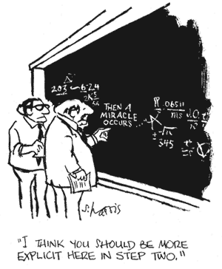

Slide 25
EM for Univariate GMMs
Initialize:
Iterate:
E-step: compute expectation of z variables
M-step: compute new model parameters

Slide 26
MapReduce Implementation
x₁
z_{1,1}
z_{1,2}
…
z_{1,K}
Map
x₂
z_{2,1}
z_{2,2}
z_{2,K}
x₃
z_{2,1}
z_{2,3}
z_{2,K}
…
x_{N}
z_{N,1}
z_{N,2}
z_{N,K}
Reduce

Slide 27
K-Means vs. GMMs
K-Means
GMM
Map
Compute distance of points to centroids
E-step: compute expectation of z indicator variables
Reduce
M-step: update values of model parameters
Recompute new centroids

Slide 28
Summary
Hierarchical clustering
Difficult to implement in MapReduce
K-Means
Straightforward implementation in MapReduce
Gaussian Mixture Models
Implementation conceptually similar to k-means, more “bookkeeping”

Slide 29

Classification
Source: Wikipedia (Sorting)

Slide 30
Supervised Machine Learning
The generic problem of function induction given sample instances of input and output
Classification: output draws from finite discrete labels
Regression: output is a continuous value
Focus here on supervised classification
Suffices to illustrate large-scale machine learning
This is not meant to be an exhaustive treatment of machine learning!

Slide 31
Applications
Spam detection
Content (e.g., movie) classification
POS tagging
Friendship recommendation
Document ranking
Many, many more!

Slide 32
Supervised Binary Classification
Restrict output label to be binary
Yes/No
1/0
Binary classifiers form a primitive building block for multi-class problems
One vs. rest classifier ensembles
Classifier cascades

Slide 33
Limits of Supervised Classification?
Why is this a big data problem?
Isn’t gathering labels a serious bottleneck?
Solution: user behavior logs
Learning to rank
Computational advertising
Link recommendation
The virtuous cycle of data-driven products

Slide 34
The Task
label
Given
(sparse) feature vector
Induce
Such that loss is minimized
loss function
Typically, consider functions of a parametric form:
model parameters

Slide 35
Key insight: machine learning as an optimization problem!
(closed form solutions generally not possible)

Slide 36
Gradient Descent: Preliminaries
Rewrite:
Compute gradient:
“Points” to fastest increasing “direction”
So, at any point:
*
* caveats

Slide 37
Gradient Descent: Iterative Update
Start at an arbitrary point, iteratively update:
We have:
Lots of details:
Figuring out the step size
Getting stuck in local minima
Convergence rate
…

Slide 38
Gradient Descent
Repeat until convergence:

Slide 39
Intuition behind the math…
New weights
Old weights
Update based on gradient

Slide 40
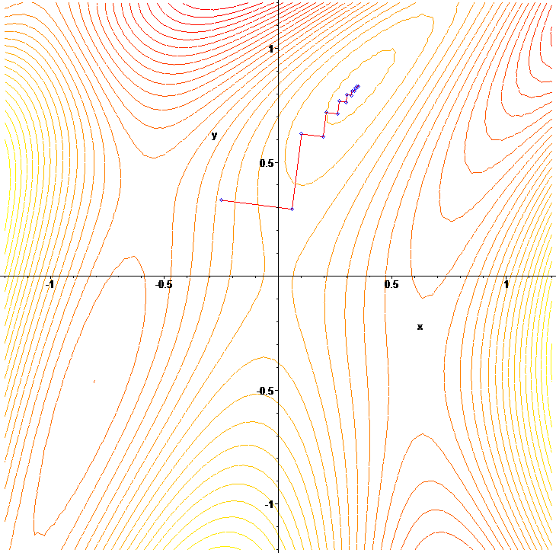
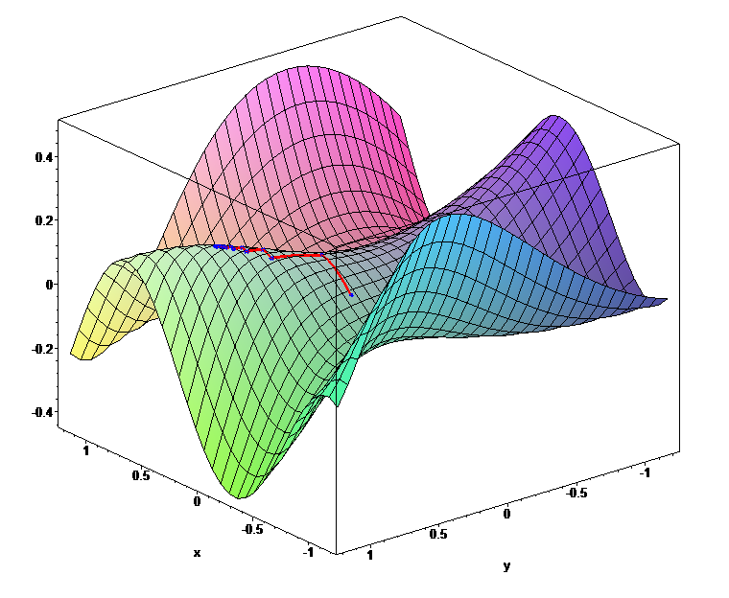

Slide 41
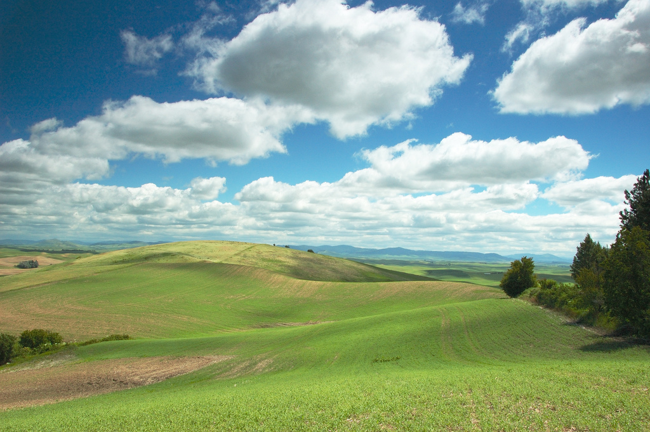
Gradient Descent
Source: Wikipedia (Hills)

Slide 42
Lots More Details…
Gradient descent is a “first order” optimization technique
Often, slow convergence
Conjugate techniques accelerate convergence
Newton and quasi-Newton methods:
Intuition: Taylor expansion
Requires the Hessian (square matrix of second order partial derivatives): impractical to fully compute

Slide 43
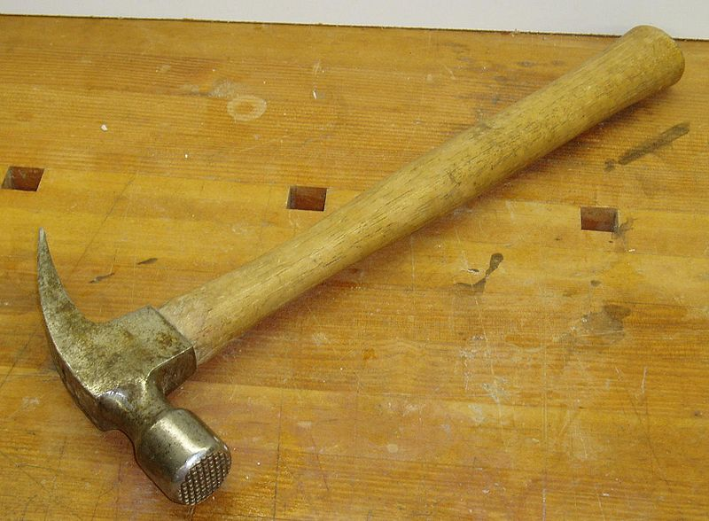
Logistic Regression
Source: Wikipedia (Hammer)

Slide 44
Logistic Regression: Preliminaries
Given
Let’s define:
Interpretation:

Slide 45
Relation to the Logistic Function
After some algebra:
The logistic function:

Slide 46
Training an LR Classifier
Maximize the conditional likelihood:
Define the objective in terms of conditional log likelihood:
We know so:
Substituting:

Slide 47
LR Classifier Update Rule
Take the derivative:
General form for update rule:
Final update rule:

Slide 48
Lots more details…
Regularization
Different loss functions
…
Want more details? Take a real machine-learning course!

Slide 49
MapReduce Implementation
mappers
single reducer
compute partial gradient
mapper
mapper
mapper
mapper
reducer
iterate until convergence
update model

Slide 50
Shortcomings
Hadoop is bad at iterative algorithms
High job startup costs
Awkward to retain state across iterations
High sensitivity to skew
Iteration speed bounded by slowest task
Potentially poor cluster utilization
Must shuffle all data to a single reducer
Some possible tradeoffs
Number of iterations vs. complexity of computation per iteration
E.g., L-BFGS: faster convergence, but more to compute

Slide 51
Gradient Descent
Source: Wikipedia (Hills)

Slide 52
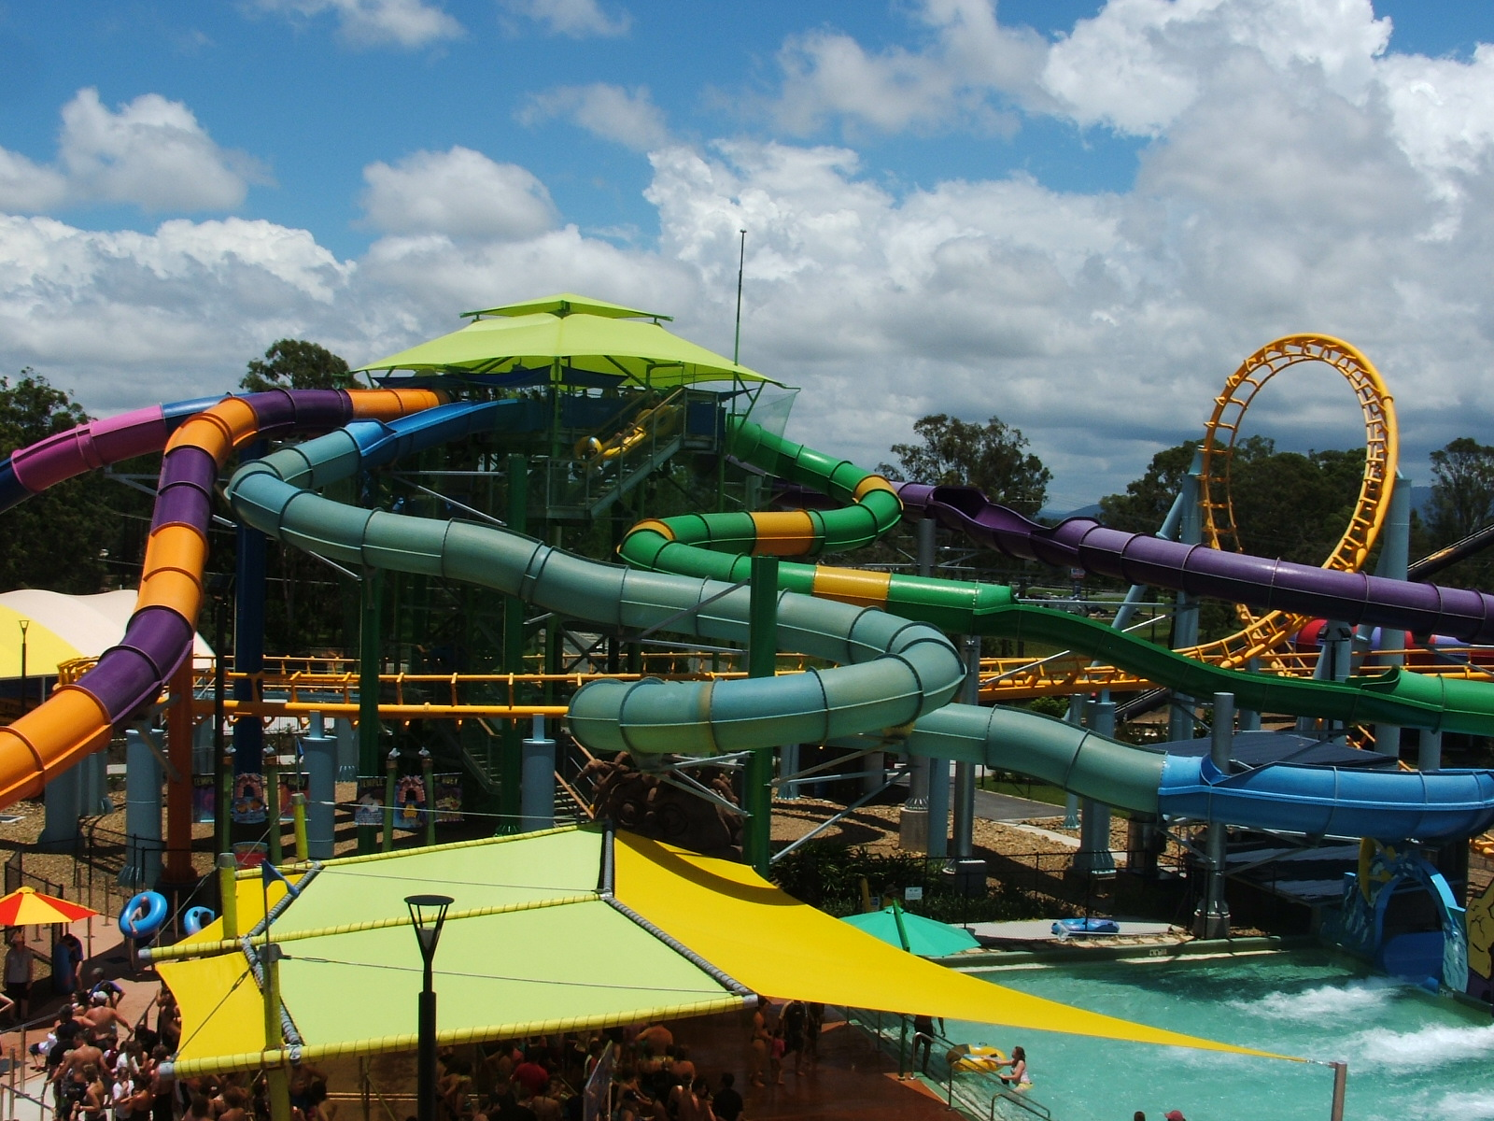
Stochastic Gradient Descent
Source: Wikipedia (Water Slide)

Slide 53
Batch vs. Online
Gradient Descent
“batch” learning: update model after considering all training instances
Stochastic Gradient Descent (SGD)
“online” learning: update model after considering each (randomly-selected) training instance
In practice… just as good!

Slide 54
Practical Notes
Most common implementation:
Randomly shuffle training instances
Stream instances through learner
Single vs. multi-pass approaches
“Mini-batching” as a middle ground between batch and stochastic gradient descent
We’ve solved the iteration problem!
What about the single reducer problem?

Slide 55
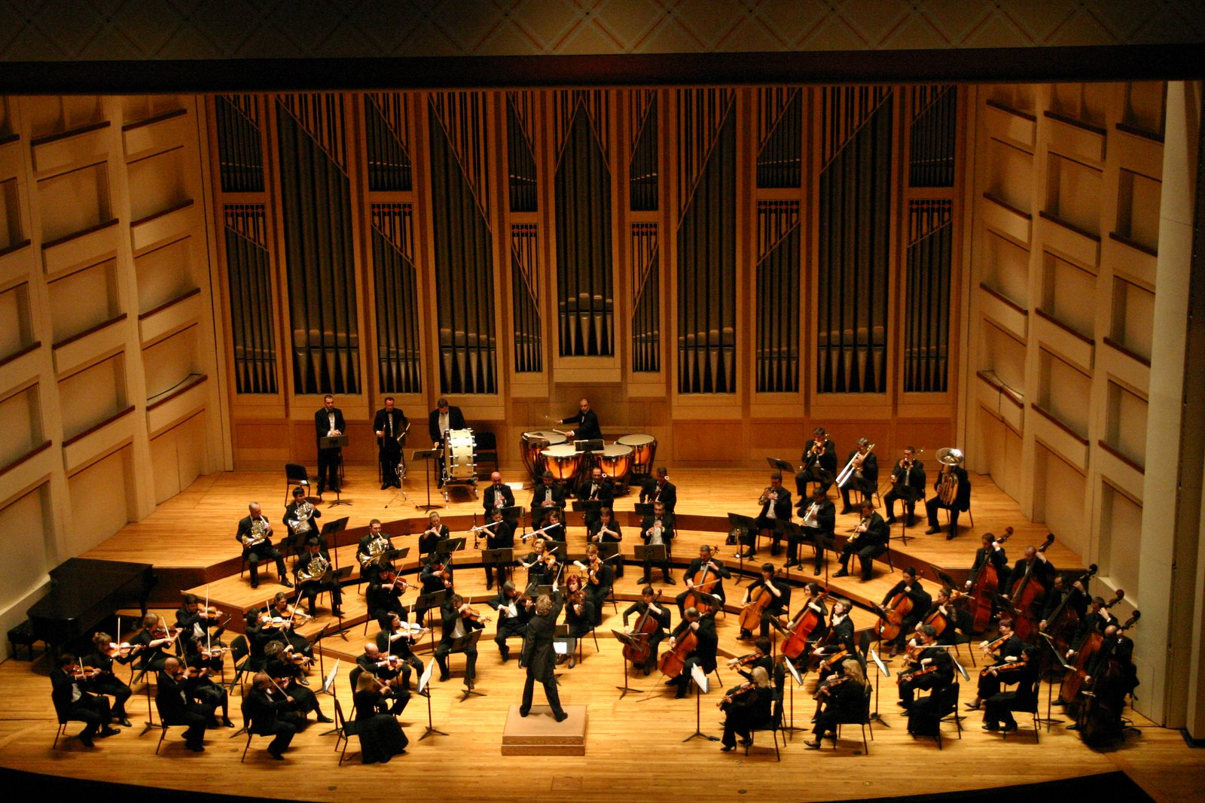
Ensembles
Source: Wikipedia (Orchestra)

Slide 56
Ensemble Learning
Learn multiple models, combine results from different models to make prediction
Why does it work?
If errors uncorrelated, multiple classifiers being wrong is less likely
Reduces the variance component of error
A variety of different techniques:
Majority voting
Simple weighted voting:
Model averaging
…

Slide 57
Practical Notes
Common implementation:
Train classifiers on different input partitions of the data
Embarassingly parallel!
Contrast with bagging
Contrast with boosting

Slide 58
MapReduce Implementation
training data
training data
training data
training data
mapper
mapper
mapper
mapper
model
model
model
model

Slide 59
MapReduce Implementation: Details
Shuffling/resort training instances before learning
Two possible implementations:
Mappers write model out as “side data”
Mappers emit model as intermediate output

Slide 60
Sentiment Analysis Case Study
Lin and Kolcz, SIGMOD 2012
Binary polarity classification: {positive, negative} sentiment
Independently interesting task
Illustrates end-to-end flow
Use the “emoticon trick” to gather data
Data
Test: 500k positive/500k negative tweets from 9/1/2011
Training: {1m, 10m, 100m} instances from before (50/50 split)
Features: Sliding window byte-4grams
Models:
Logistic regression with SGD (L2 regularization)
Ensembles of various sizes (simple weighted voting)

Slide 61
Diminishing returns…
Ensembles with 10m examples better than 100m single classifier!
“for free”
single classifier
10m ensembles
100m ensembles

Slide 62
Takeaway Lesson
Big data “recipe” for problem solving
Simple technique
Simple features
Lots of data
Usually works very well!

Slide 63
Today’s Agenda
Personalized PageRank
Clustering
Classification

Slide 64

Questions?
Source: Wikipedia (Japanese rock garden)

